Slide 1
CMP 839: Programming Fundamentals
Session 2 www.profburnett.com

Slide 2
Session Outline
Part II - Programming Basics
Part II - Chapter 1 How Programs Work
Part II - Chapter 2 Variables, Data Types, and Constants
Part II - Chapter 3 Manipulating Data
Part II - Chapter 4 Making Decisions by Branching
Part II - Chapter 5 Repeating Commands by Looping
Part II - Chapter 6 Breaking a Large Program into Subprograms
Part II - Chapter 7 Breaking a Large Program into Objects
Part II - Chapter 9 Documenting Your Program

Slide 3
Chapter 1 - How Programs Work - Programming Process
Six programming phases:
Understand the problem
Plan the logic
Code the program
Use software to translate the program to machine language
Test the program
Deploy the program into production

Slide 4
Programming Process
1. Understanding the problem:
May be the most difficult phase
Users may not be able to articulate their needs well
User needs may be changing frequently
Programmers may have to learn the user’s functional job tasks
Failure to understand the problem is the major cause of most project failures

Slide 5
Programming Process
2. Planning the logic:
Plan the steps that the program will take
Use tools such as flowcharts and pseudocode
Flowchart: a pictorial representation of the logic steps
Pseudocode: English-like representation of the logic
Walk through the logic before coding by desk-checking the logic

Slide 6
Programming Process
3. Coding the program:
Select the programming language
Write the instructions
4. Using software to translate the program into machine language:
Programmers write instructions in English-like high-level languages
Compilers or interpreters change the programs into low-level machine language that can be executed
Syntax errors are identified by the compiler or interpreter

Slide 7
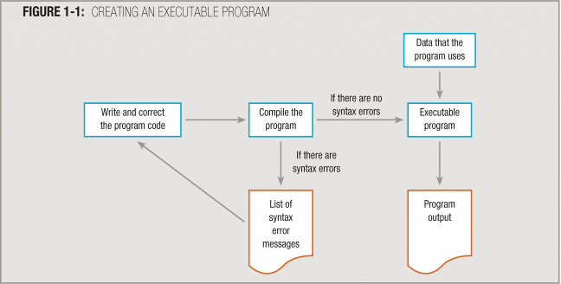
Programming Process

Slide 8
Programming Process
5. Testing the program:
Execute it with sample data and check results
Identify logic errors and correct them
Choose test data carefully to exercise all branches of the logic
6. Putting the program into production
Do this after testing is complete and all known errors have been corrected
May require coordination with other related activities or software

Slide 9
Modules, Subroutines, Procedures, Functions, or Methods
Programmers seldom write programs as one long series of steps
Instead, they break the programming problem down into reasonable units, and tackle one small task at a time
These reasonable units are called modules
Programmers also refer to them as subroutines, procedures, functions, or methods

Slide 10
Chapter 2 Variables, Data Types, and Constants

Slide 11
Declaring Variables
The primary work of most modules in most programs you write is to manipulate data
Many program languages require you to declare all variables before you use them
Declaring a variable involves:
providing a name for the memory location where the computer will store the variable values, and
notifying the computer of what type of data to expect

Slide 12
Declaring Variables
Every programming language has specific rules for declaring variables, but all involve identifying at least two attributes for every variable:
Declaring a data type
Giving the variable a name
In many modern programming languages, variables typically are declared within each module that uses them
Known as local variables

Slide 13
Declaring Variables
Global variables - variables given a type and name once, and then used in all modules of the program
Annotation symbol or annotation box - an attached box containing notes
Use when you have more to write than can conveniently fit within a flowchart symbol
Data dictionary - a list of every variable name used in a program, along with its type, size, and description

Slide 14
Understanding Data Types
Two basic data types:
Text
Numeric
Numeric data stored by numeric variables
Text data stored by string, text, or character variables
Constants:
Values that do not change while the program is running
Have identifiers, and can be used like variables for calculations, but cannot be assigned new values

Slide 15
Understanding Data Types
Some programming languages implement several numeric data types, such as:
Integer: whole numbers only
Floating-point: fractional numeric values with decimal points
Character or string data is represented as characters enclosed in quotation marks
“x”, “color”
Data types must be used appropriately

Slide 16
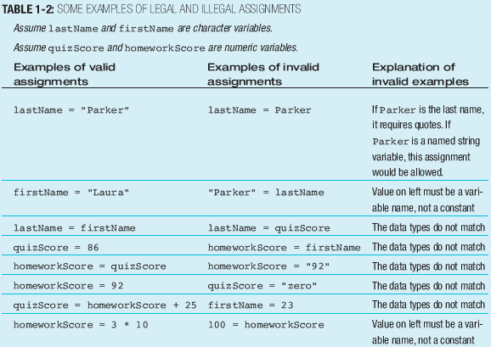
Understanding Data Types

Slide 17
Chapter 3 Manipulating Data
Assignment Operators
Math Operators
String Manipulation
Comparison and Boolean Operators
Data Conversions

Slide 18
Assigning Values to Variables
Assignment statement:
Assigns a value to a variable
Variable must appear on the left side, value on the right side of the assignment operator
Right side may be an expression that will be evaluated before storing the value in the variable
Assignment operator: the equal sign (=) in most languages
Variable:
Memory location: has an address and a value
Value (contents) is used for various operations

Slide 19
Math Operators
Operation | Symbol | Example | Result
Addition | + | 3 + 10.27 | 13.27
Subtraction | - | 89.4 – 9.2 | 80.2
Multiplication | * | 5 * 9 | 45
Division | / | 120 / 5 | 24
Integer Division | \ | 6 \ 4 | 1
Modulus | %^ or mod | 6 % 4 or 6 mod 4 | 2
Exponentiation | ^ | 2^4 | 16

Slide 20
Order of Precedence
Precedence | Operation | Operator
1 | Exponentiation | ^
2 | Multiplication | *
3 | Division | /
4 | Integer Division | \
5 | Modulus | %^ or mod
6 | Addition | +
7 | Subtraction | -
Y = 34 + 7 * 89
Y = 34 + 623
Y = 657
Y = (34 + 7) * 89
Y = 41 * 89
Y = 3649

Slide 21
String Manipulation
Concatenation Operators
Language | Operator
JavaScript | + , +=, .concat
Visual Basic | + , &
C | +, strcat
C++ | +, strcat
C# | str , +, +=
Java | +, concat()
Python | +
PHP | . , .=
Perl | .
Ruby | + , <<

Slide 22
Comparison and Boolean Operators
Boolean logic
Form of Algebra
True or False
Binary Numbering System
Bit has a value of either 1 or 0

Slide 23
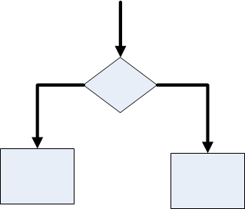
Boolean Expressions Make Comparisons
Dual-alternative (or binary) selection structure:
Provides an action for each of two possible outcomes

Slide 24
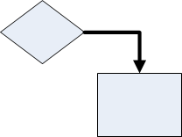
Boolean Expressions Make Comparisons
Single-alternative (or unary) selection structure
Action is provided for only one outcome

Slide 25
Boolean Expressions Make Comparisons
Dual-alternative (or binary) selection structure:
Also called an if-then-else structure
if hourWorked > 40 then
grossPay = 40 * rate +
(hoursWorked – 40) * 1.5 * rate
else
grossPay = hoursWorked * rate
endif

Slide 26
Boolean Expressions Make Comparisons
Single-alternative (or unary) selection structure
Also called an if-then structure
if dentalPlan = “Y” then
grossPay = grossPay – 23.50
endif

Slide 27
Using the Relational Comparison Operators
Six possible ways to compare two values:
Both are equal
The first is greater than the second
The first is less than the second
The first is greater than or equal to the second
The first is less than or equal to the second
The two values are not equal

Slide 28
Using the Relational Comparison Operators
Relational comparison operators:
To express Boolean tests when comparing values
Different languages use different symbols
Equals: =
Less than: <
Greater than: >
Less than or equal: <=
Greater than or equal: >=

Slide 29
Using the Relational Comparison Operators
Any logical situation can be expressed with only three types of comparisons: =, >, and <
>= and <= are not necessary, but make code more readable
Adjust the logic based on the comparison type
if customer age >= 65 then
discount = 0.10
else
discount = 0
endif
if customer age < 65 then
discount = 0
else
discount = 0.10
endif

Slide 30
Using the Relational Comparison Operators
Rule of thumb: ask the question most likely to have a positive outcome
Avoid “not equal” when it results in a double negative
if customerCode not equal to 1 then
discount = 0.25
else
discount = 0.50
endif

Slide 31
Using the Relational Comparison Operators
Rephrase in the positive
if customerCode = 1 then
discount = 0.50
else
discount = 0.25
endif
Some comparisons are clearer when negative is used

Slide 32
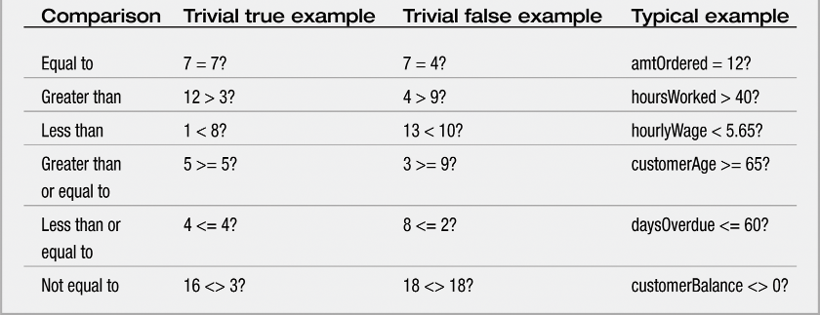
Using the Relational Comparison Operators

Slide 33
Relational Comparison Operators
Language | Operator | Use
JavaScript |  | + , +=, .concat
Visual Basic, Pascal | <> | “not equal to”
Visual Basic, Pascal | = | “equal to”
C, C++, C# | == | “equal to”
C, C++, C# | != | “not equal to”

Slide 34
Boolean Operators
Not
And
Or
Xor

Slide 35
Boolean Operator - NOT
Converts Boolean to opposite value
not(true) = false
Age = 3
Not(Age > 2)
Not(3 > 2)
Not(True)
False

Slide 36
Boolean Operator - And
And Truth Table
First Value | Second Value | Result
True | True | True
True | False | False
False | True | False
False | False | False
Age = 3
(Age > 2) AND (Age >= 18)
(3 > 2) AND (3 >= 18)
True AND False
False
Age = 25
(Age > 2) AND (Age >= 18)
(25 > 2) AND (25 >= 18)
True AND True
True

Slide 37
Boolean Operator - Xor
Xor Truth Table
First Value | Second Value | Result
True | True | False
True | False | True
False | True | True
False | False | False
Age = 3
(Age > 2) OR (Age >= 18)
(3 > 2) OR (3 >= 18)
True OR False
True
Age = 1
(Age > 2) OR (Age >= 18)
(1 > 2) OR (1 >= 18)
False OR False
False

Slide 38
Boolean Operator - And
And Truth Table
First Value | Second Value | Result
True | True | True
True | False | False
False | True | False
False | False | False
Age = 3
(Age > 2) XOR (Age >= 18)
(3 > 2) XOR (3 >= 18)
True XOR False
True
Age = 1
(Age > 2) XOR (Age >= 18)
(1 > 2) XOR (1 >= 18)
False XOR False
True

Slide 39
Data Conversions
Variable Typing
Type-Safe – Forces you to declare type of data before you use them.
Typeless – Stores and type of data

Slide 40
Chapter 4 Making Decisions by Branching
Three Basic Program Structures
IF-THEN
Multiple Boolean Operators
Select Case Statement

Slide 41
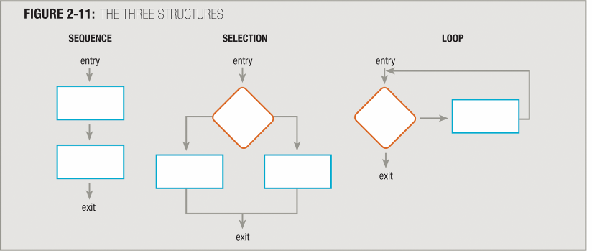
Three Basic Program Structures
Each structure has one entry and one exit point
Structures attach to others only at entry or exit points

Slide 42
Three Special Structures
Many languages allow three additional structures:
case structure
do-while structure
do-until structure

Slide 43
IF-Then Statement
Command
User Hit the Pause Button
True
Pause game
False
Command

Slide 44
IF-Then-Else Statement
Command
Command Operation
True
False
Command
Command
Command

Slide 45
IF-Then-Elseif Statement
Command
Command Operation
True
False
Command Operation
True
False
Command
False
Command
Command

Slide 46
Multiple Boolean Operators
Multiple Boolean Values Result in “True” or “False” Value
Value of Age Variable | Value of (Age > 20) Expression | Value of (Age > 20) Expression | Value of Completed Boolean Expression
15 | False | True | False
35 | True | True | True
78 | True | False | False

Slide 47
Case Structure
Decisions with more than two alternatives
Tests a variable against a series of values and takes action based on a match
Nested if-then-else statements will do what a case structure does
SELECT CASE Age
CASE 65
Status = Retired
CASE 21
Status = Working
CASE 15
Status = Student
Case 3
Status = ?
END SELECT

Slide 48
Chapter 5 Repeating Commands by Looping
Looping Fixed Number of Loops
Looping Zero or More with While
Looping at least Once with Do Loop
Nested Loops

Slide 49
Looping Sequence
Command
True
Command
Loop Again?
False
Command

Slide 50
Using the for Statement
Indeterminate (or indefinite) loop: when the number of executions of the loop is not known in advance
Definite loop: when the number of executions of the loop is known in advance
while statement can be used with both definite and indefinite loops
for statement can be used with definite loops

Slide 51
Looping Fixed Number of Loops
For–Next Loop
A variable
Initial Value
Ending Value
One or more Commands
FOR Variable = InitialValue to EndValue
Command
Next Variable
FOR EmployeeID = 1 to 150
Print EmployeeName
Next EmployeeID
FOR I = 1 to 15
Print EmployeeName
Next I

Slide 52
Looping in C
for (i = 1, i <= 15 i++)
{
printif (“John Smith”);
}
Increment Operator
i++ is equal to i = i + 1
Decrement Operator
i-- is equal to i = i - 1

Slide 53
Looping Zero or More with While
Loop control variable: determines whether a loop will continue to execute
Sentinel value: a limit or ending value to compare with the loop control variable
Loop body: statements inside the loop that are executed repetitively
Once the loop body is entered, the entire loop body must execute
Can exit from a structured loop only at the comparison test of the loop control variable

Slide 54
Using a while Loop with a Loop Control Variable
Rep = 1
While rep < 5
print = “Warning!”
rep = rep + 1
endwhile

Slide 55
Using the do while and do until Loops
With a pretest loop (for or while), the loop body may never execute
With a posttest loop, the loop body is always executed at least once
do while loop continues to execute as long as the condition remains true
do until loop continues to execute as long as the condition remains false

Slide 56
Using the do while Loop
createLabels
labelCounter = 0
labelToPrint = inLastProduction * 1.1
print labelLine, inFirst Name
while labelCounter < labelsToPrint
print labelLine, inFirst Name
labelCounter = labelCounter + 1
endwhile
read empRecord
return

Slide 57
Using the do until Loop
createLabels
labelCounter = 0
labelToPrint = inLastProduction * 1.1
do
print labelLine, inFirst Name
labelCounter = labelCounter + 1
until labelCounter > labelToPrint
read empRecord
return

Slide 58
Nesting Loops
produceReport
print heading1
print firstName, lastName
print heading2
monthCounter = 1
while monthCounter <= MONTHS_IN_A_YEAR
checkcounter = 1
while checkCounter <= CHECKS_IN_A_MONTH
weekSal = weekSal + weekSal * RAISE_RATE
print monthCounter, checkCounter, weekSal
checkCounter = checkCounter + 1
endwhile
monthCounter = monthCounter + 1
endwhile
read payRec
return

Slide 59
Avoiding Common Loop Mistakes
Neglecting to initialize the loop control variable
Neglecting to alter the loop control variable
Using the wrong comparison with the loop control variable
Including statements inside the loop that belong outside the loop
Initializing a variable that does not require initialization

Slide 60
Chapter 6 Breaking a Large Program into Subprograms
The process of breaking a large program into subprograms or modules is called modularization
Provides abstraction
Allows multiple programmers to work on a problem
Allows you to reuse your work
Makes it easier to identify structures

Slide 61
Modularization Provides Abstraction
Abstraction:
Process of paying attention to important properties while ignoring nonessential details (selective ignorance)
Makes complex tasks look simple
Some level occurs in every computer program

Slide 62
Modularization Provides Abstraction
Fifty years ago, an understanding of low-level circuitry instructions was necessary
Now, newer high-level programming languages allow you to use English-like vocabulary in which one broad statement corresponds to dozens of machine instructions
Modules or subroutines provide another way to achieve abstraction

Slide 63
Modularization Allows Multiple Program Work
When you dissect any large task into modules, you gain the ability to divide the task among various people
Rarely does a single programmer write a commercial program that you buy off the shelf
Modularization thus allows professional software developers to write new programs in weeks or months, instead of years

Slide 64
Modularization Allows Reuse
If a subroutine or function is useful and well-written, you may want to use it more than once within a program or in other programs
You can find many real-world examples of reusability where systems with proven designs are incorporated, rather than newly invented, by individuals beginning a certain task

Slide 65
Modularization Makes Easy Structures
When you combine several programming tasks into modules, it may be easier for you to identify structures

Slide 66
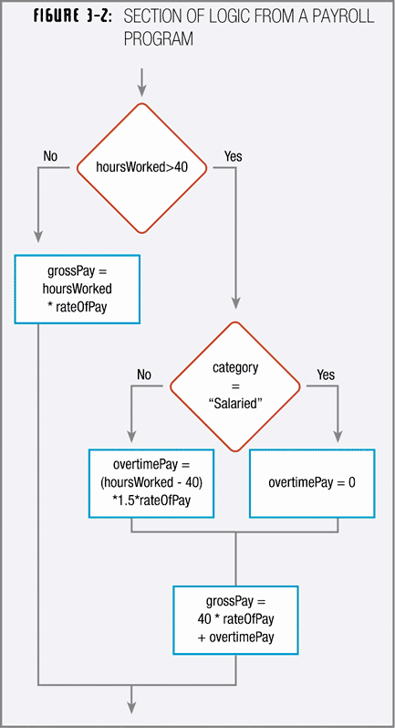
Modularization Makes Easy Structures
When you work with a program segment like the diagram you may question whether it is structured

Slide 67
Modularization Makes Easy Structures
If you can modularize some of the statements and give them a more abstract group name
that the program involves a major selection
that the program segment is structured

Slide 68
Modularizing a Program
When you create a module or subroutine, you give it a name
In this text, module names follow the same two rules used for variable names:
Must be one word
Should have some meaning

Slide 69
Modularizing a Program
When a program uses a module, you can refer to the main program as the calling program
Whenever a main program calls a module, the logic transfers to the module
When the module ends, the logical flow transfers back to the main calling program and resumes where it left off

Slide 70
Modularizing a Program

Slide 71
Modules Calling Other Modules
Determining when to break down any particular module further into its own subroutines or submodules is an art
Some companies may have arbitrary rules, such as:
“a subroutine should never take more than a page,” or
“a module should never have more than 30 statements in it,” or
“never have a method or function with only one statement in it”

Slide 72
Modules Calling Other Modules
A better policy is to place together statements that contribute to one specific task
The more the statements contribute to the same job, the greater the functional cohesion of the module

Slide 73
Chapter 7 Breaking a Large Program into Objects
Understanding Object-Oriented Programming
Object-Oriented Programming Languages

Slide 74
Object Oriented Concepts
Abstraction
Encapsulation
Inheritance
Polymorphism
Classes
Objects
State Retention
Genericity
Messaging
Metadata

Slide 75
Abstraction
Simplifying complex reality by modeling classes appropriate to the problem.
Working at the most appropriate level of inheritance for a given aspect of the problem.
Music
Classical
Jazz
Country
Pop
Rap
Rock
Ska
Heavy Metal

Slide 76
Encapsulation
Conceals the exact details of how a particular class works from objects that use its code or send messages to it.
Encapsulation is achieved by specifying which classes may use the members of an object.
The result is that each object exposes to any class a certain interface — those members accessible to that class.
Members are often specified as public, protected and private, determining whether they are available to all classes, sub-classes or only the defining class.
Lyrics
Song
Melodies

Slide 77
Encapsulation Implementation
Java uses the protected keyword to restrict access also to classes in the same package.
C# and VB.NET reserve some members to classes in the same assembly using keywords internal (C#) or Friend (VB.NET).
Eiffel allows one to specify which classes may access any member.

Slide 78
Inheritance
A class will have "subclasses," more specialized versions of a class.
When an object or class inherits its traits from more than one ancestor class, it's called multiple inheritance. This is not always supported, as it can be hard both to implement and to use well.
Music
Classical
Lyrics
Song
Jazz
Country
Pop
Melodies
Rock

Slide 79
Polymorphism
Behavior that varies depending on the class in which the behavior is invoked.
Song
Lyrics
What other song has these lyrics?
Melodies
Are these lyrics from a poem?

Slide 80
Classes
A class defines the abstract characteristics of a entity.
An entities characteristics includes:
Properties or Attributes
Methods or Behaviors
Collectively, the properties and methods defined by a class are called members.
Classes provide modularity and structure.
Characteristics of the class should make sense in context.
Code is relatively self-contained.
Track
Album
Property
Song
Music
Video
Method

Slide 81
Object Characteristics
A particular instance of a class.
State
Properties or Attributes
Methods or Behaviors

Slide 82
Object Characteristics State Retention
Describes the data stored in the object.
The set of values of the attributes of a particular object is called its state.

Slide 83
Object Characteristics Properties
Identity - the property of an object that distinguishes it from other objects
State - describes the data stored in the object
Methods or Behavior - describes the methods in the object's interface by which the object can be used

Slide 84
Object Characteristics Methods
An object's abilities.
Within the program, using a method should only affect one particular object.

Slide 85
Genericity
The construction of a class so that one or more of the classes that it uses internally is supplied only at run-time (when object is instantiated)

Slide 86
Messaging
The process by which an object sends data to another object or asks the other object to invoke a method.
Informative – Update. Forward, Push
Interrogative – read, backward, Pull
Imperative – force, action

Slide 87
Metadata
Metadata are data on data.
Metadata is information about data.
Metadata is information about information.
Structured, encoded data that describe characteristics of information-bearing entities to aid in the identification, discovery, assessment, and management of the described entities.
Metadata is a set of optional structured descriptions that are publicly available to explicitly assist in locating objects.

Slide 88
Metadata
Content - Metadata can either describe the resource itself, e. g. name and size of a file, or the content of the resource, e. g. "The video shows a boy playing football.
Mutability - With respect to the whole resource, metadata can be either immutable, e. g. the title of a file does not change, no matter what part of the file is being considered, or mutable, e. g. the scene descriptions of a video vary.
Logical Function - There are three layers of logical function lying on top of each other: the bottom is the subsymbolic layer that contains the raw data themselves, on the symbolic layer are metadata describing the content of the raw data and the topmost logical layer contains metadata that allow logical reasoning using the symbolic layer.

Slide 89
Metadata Lifecycle
Creation - Resources need to create.
Manipulation - Must adapt if their resources change.
Destruction - Can be useful to keep even after their resource has been destroyed.

Slide 90
Object-Oriented Programming Languages
Hybrid
BASIC
C, C++
Pascal
Ada
COBOL
Pure
Eiffel
C#
Java
Perl
Python
Smalltalk

Slide 91
Chapter 9 Documenting Your Program
Adding Comments
Software Documentation
Documentation Tools

Slide 92
Adding Comments
Line Comments
Block Comments
Describing Code and Algorithms

Slide 93
Software Documentation
Design Specifications
Technical Designs
User Manuals

Slide 94
Documentation Tools
Agile Documentation
Automated Documentation
Help Files

Slide 95
Session Review
Part II - Programming Basics
Part II - Chapter 1 How Programs Work
Part II - Chapter 2 Variables, Data Types, and Constants
Part II - Chapter 3 Manipulating Data
Part II - Chapter 4 Making Decisions by Branching
Part II - Chapter 5 Repeating Commands by Looping
Part II - Chapter 6 Breaking a Large Program into Subprograms
Part II - Chapter 7 Breaking a Large Program into Objects
Part II - Chapter 9 Documenting Your Program
Next – Data Structures, Algorithms and Web Programming

